Slide 1




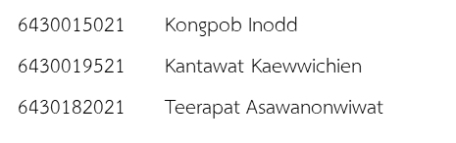
www.eng.chula.ac.th
www.eng.chula.ac.th
Isolating Trajectory Tracking From Motion Control:
A Model Predictive Control and Robust Control Framework for Unmanned Ground Vehicles
IEEE Robotics and Automation Letters, 2023

Slide 2
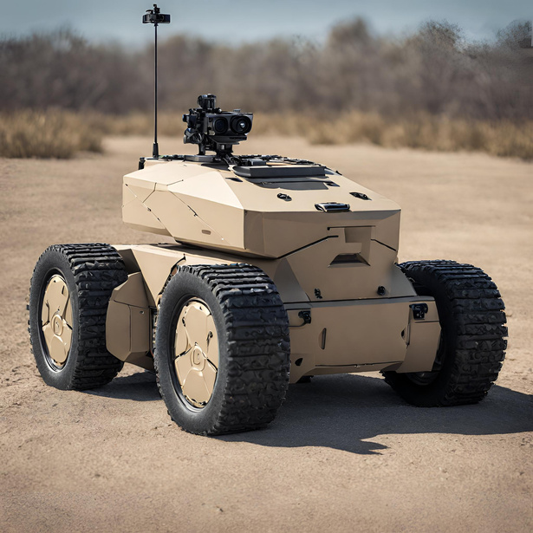
www.eng.chula.ac.th
Research Motivation
Improved Performance
Optimize Trajectory.
Handle system constraints.
Advanced Maneuvering
Complex path following.
Accuracy and stability
Independent of a task-specific objective
1

Slide 3
www.eng.chula.ac.th
Problem Formulation
Scoping the problem
Identify the problem.
Declare the objective
Formulating questions
Controller Design
Identifying solutions
Simulation and validation
Model Evaluation
2

Slide 4
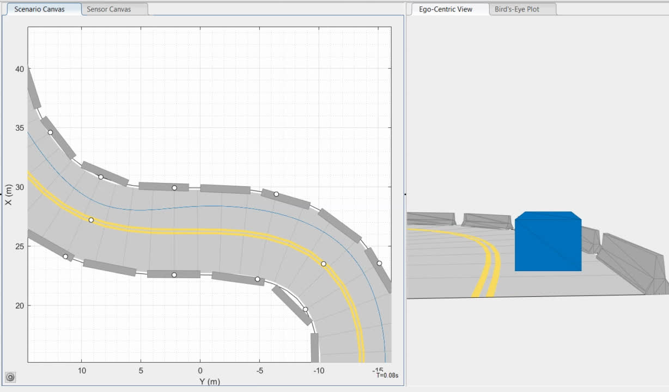
www.eng.chula.ac.th
Driving Scenario Designer

Slide 5
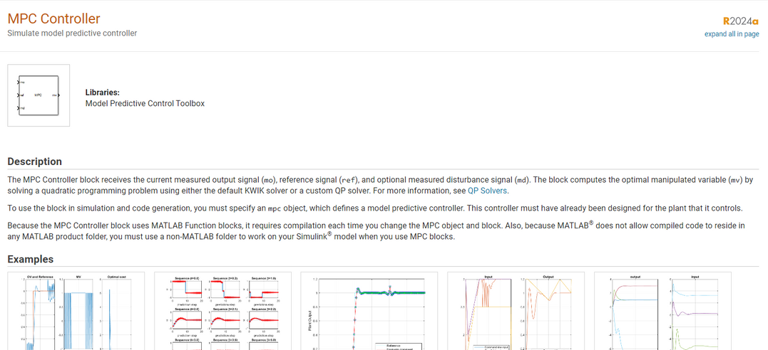
www.eng.chula.ac.th
MPC Design & Implement
Design MPC controller
Implement MPC and fine-tune controller parameters
5
ref: https://www.mathworks.com/help/mpc/ref/mpccontroller.html

Slide 6
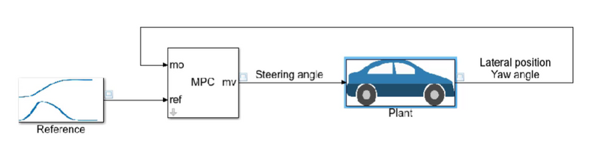
www.eng.chula.ac.th
MPC Design(1)
Specify MPC design parameters such as controller sample time, prediction
and control horizons, and constraints and weights.
ref:https://www.mathworks.com/videos/understanding-model-predictive-control-part-6-how-to-design-an-mpc-controller-with-simulink-and-model-predictive-control-toolbox-1535693503432.html
5

Slide 7
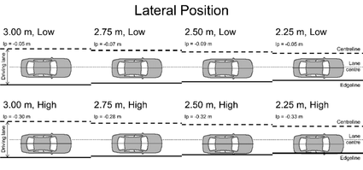
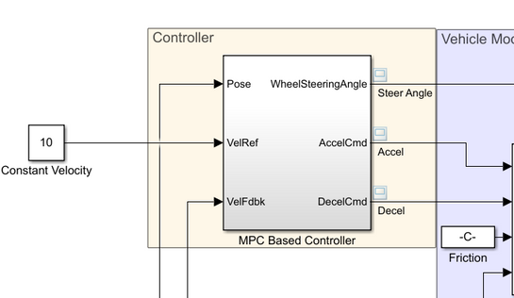
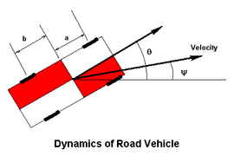
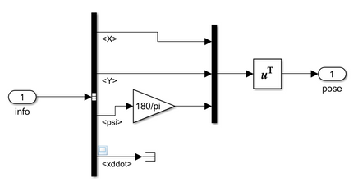
www.eng.chula.ac.th
MPC Design(2)
(1)
(1)
(2)
subsystem
5

Slide 8
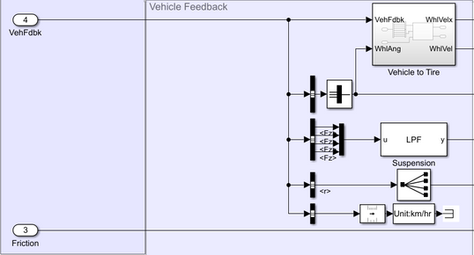
www.eng.chula.ac.th
MPC Design(3)
(3)
(3)
5

Slide 9
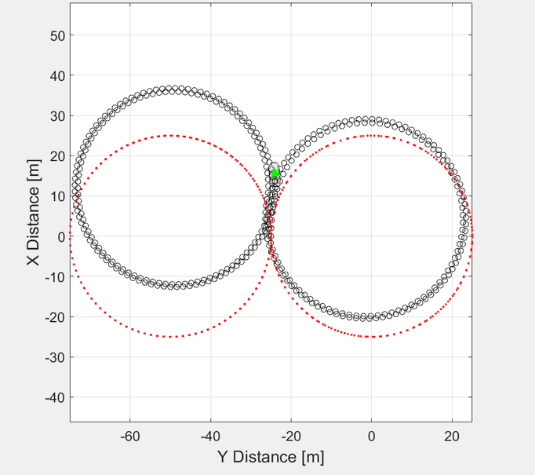
www.eng.chula.ac.th
Result
Sampling time = 1 seconds

Slide 10
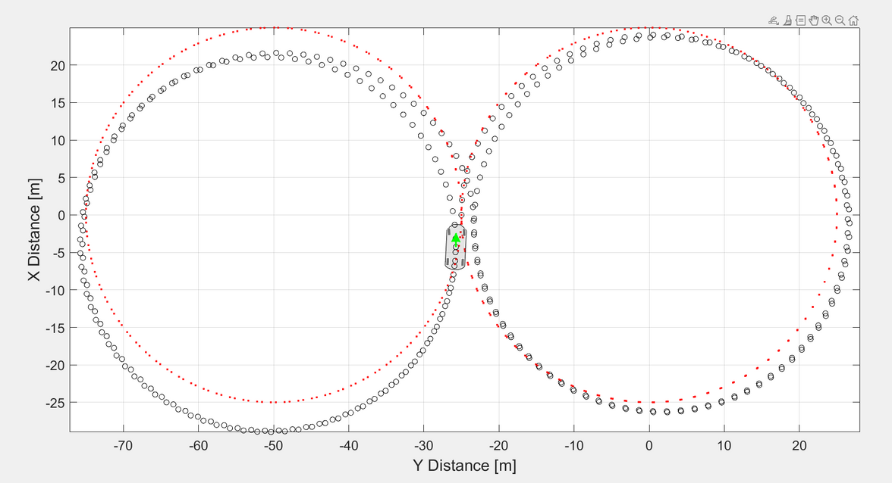
www.eng.chula.ac.th
Result
Sampling time = 0.1 seconds

Slide 11
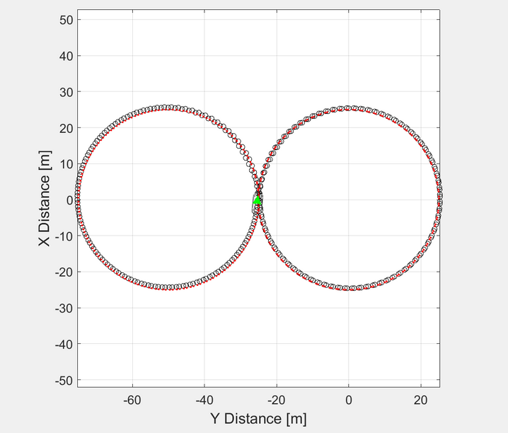
www.eng.chula.ac.th
Result
Sampling time = 0.01 seconds

Slide 12
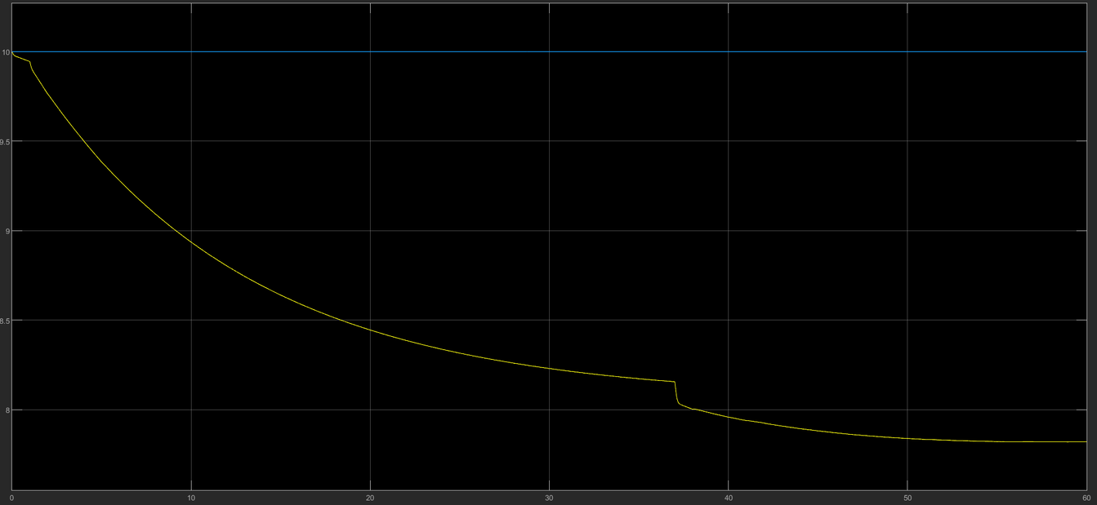
www.eng.chula.ac.th
Result
Sampling time = 1 seconds

Slide 13
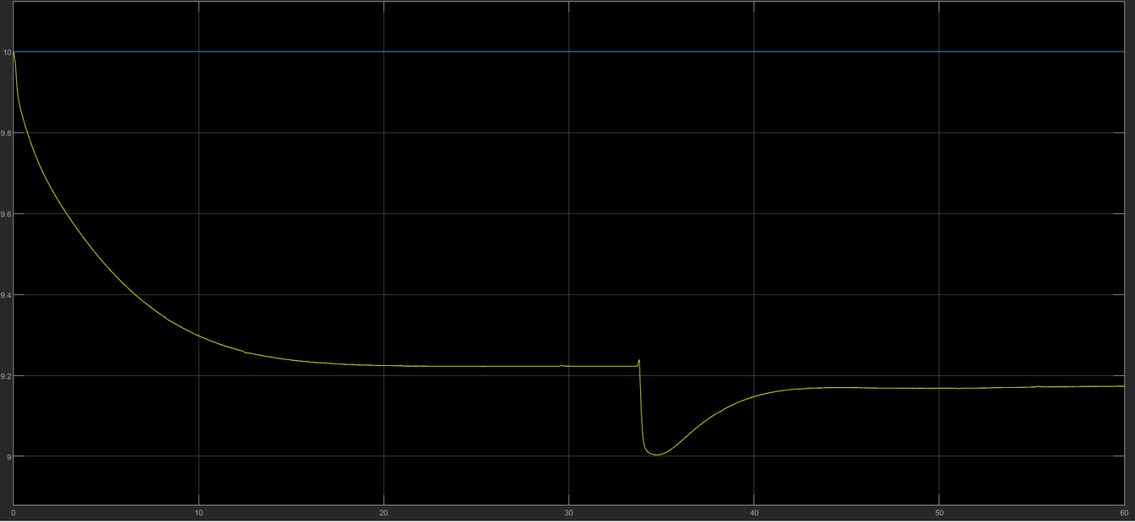
www.eng.chula.ac.th
Result
Sampling time = 0.1 seconds

Slide 14
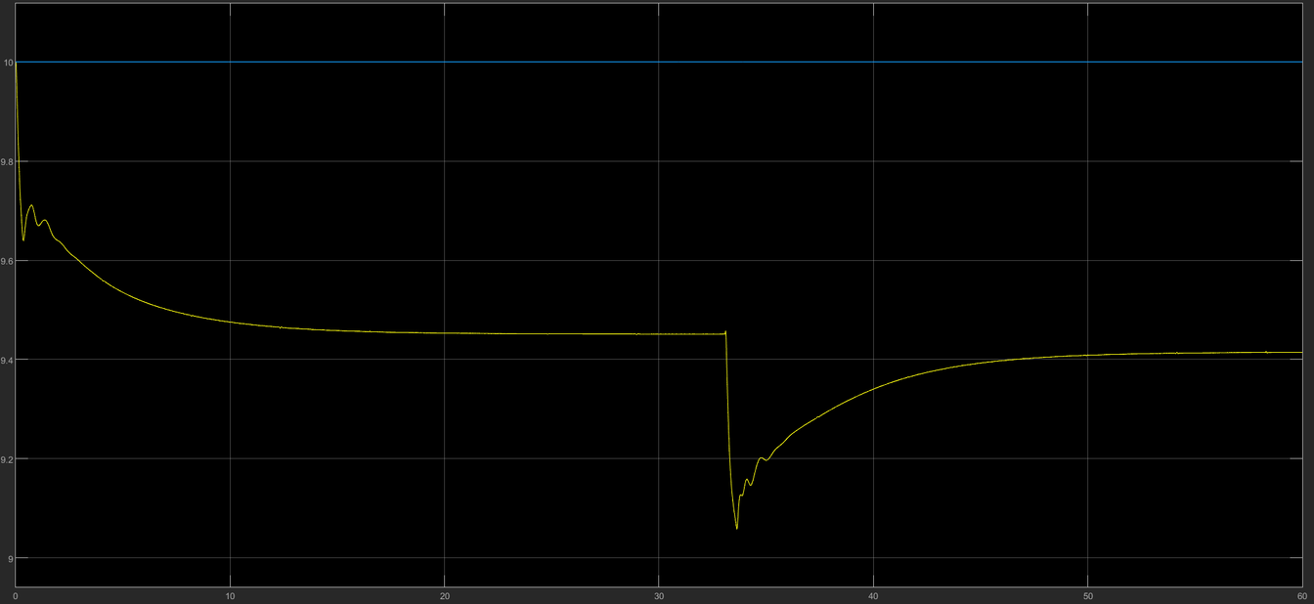
www.eng.chula.ac.th
Result
Sampling time = 0.01 seconds

Slide 15
www.eng.chula.ac.th
Conclusions
We present an MPC control method for the trajectory tracking problem.
The result is that the vehicle can track the reference trajectory accurately

